Slide 1
Configuring Windows 10 for Your Studio
Michelle King, Sales Manager | September 2017

Slide 2
Agenda
Windows 10 Creators Update
Configuring Settings
Privacy
Updates and Security
Disabling World Wide Web Publishing Services
User Accounts
User Accounts Links
User Accounts Control Slider
Device Installation Settings
Removing Onboard Audio Chipsets
Disabling Simple File Sharing
Setting Network Type as Private
Disabling Gaming/DVR Settings
Disabling IPv6
Uninstalling Native Windows Apps
Disabling Background Apps
Changing Power Options
Verifying Virtual Memory Management
Turning Off Windows Updates Entirely

Slide 3
Windows 10 Creators Update

Slide 4
Windows 10 Creators Update
Some of the new features with this update include:
  Mail app improvements,
  Microsoft Edge improvements,
  Comprehensive Windows Defender Security Center,
  Compatibility with WO Automation for Radio,
  And more, which can be discovered at https://www.microsoft.com/en-us/windows/features.

Slide 5
Configuring Settings

Slide 6
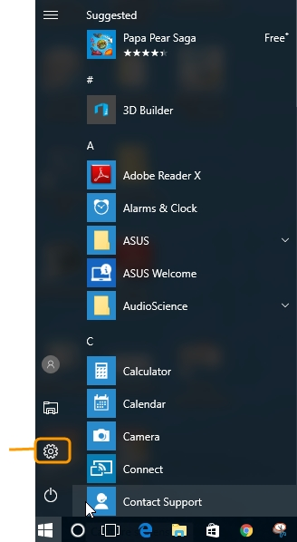
Configuring Settings
Click the Windows 10 icon, and click the Settings icon.

Slide 7
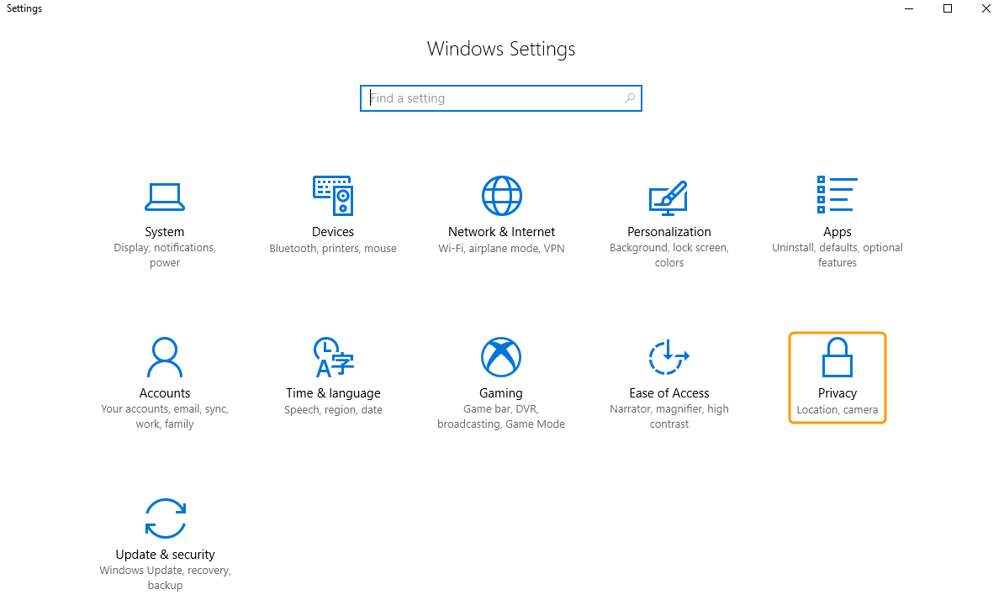
Configuring Settings
On the Windows Settings screen, click the Privacy option.

Slide 8
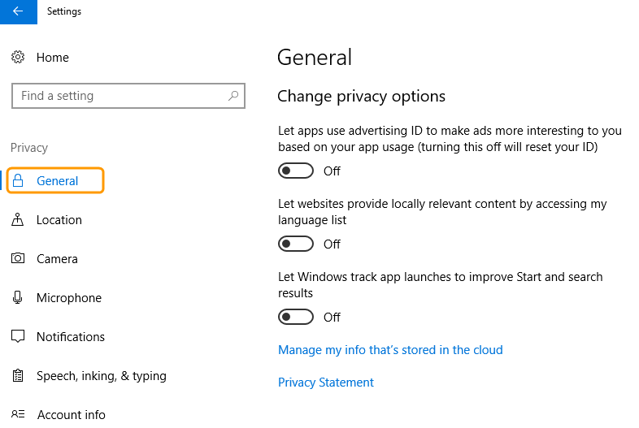
Configuring Settings
On the General tab, set all the privacy options to Off.

Slide 9
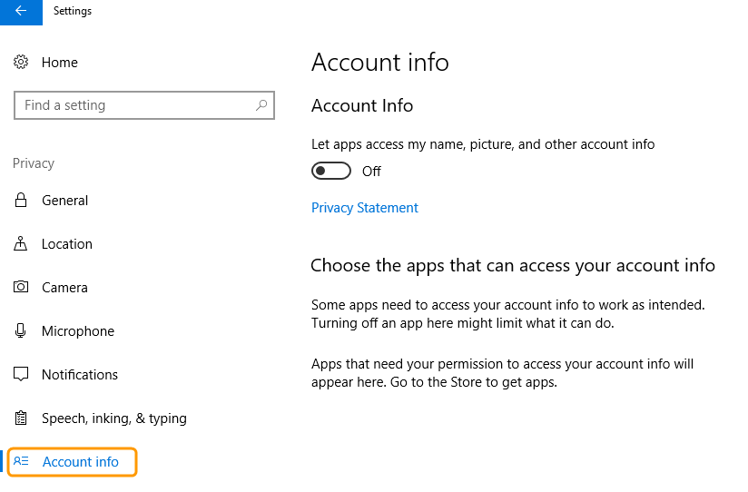
Configuring Settings
On the Account info tab, set the Account Info option to Off.

Slide 10
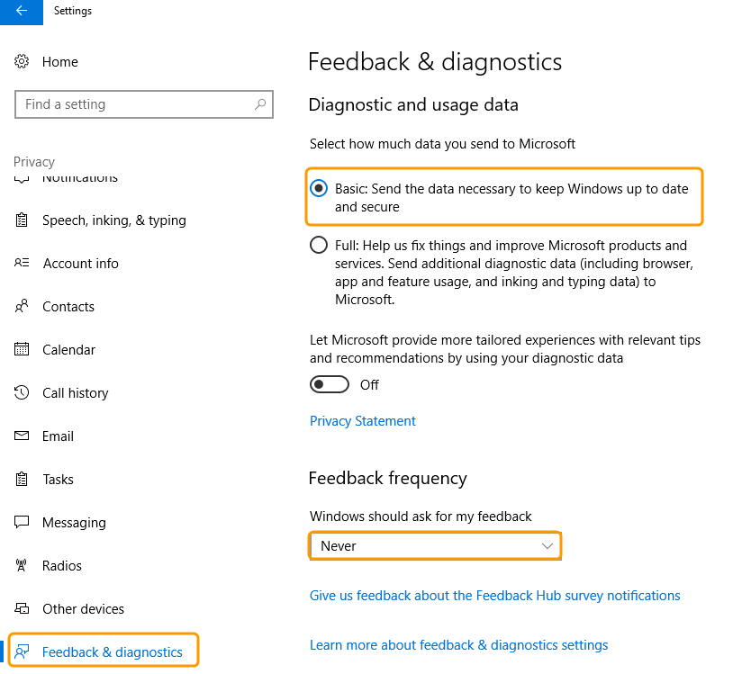
Configuring Settings
On the Feedback & diagnostics tab, select Basic from the Diagnostics and usage data section. Select Never from the Feedback frequency section.

Slide 11

Configuring Settings
Click the Back arrow in the top left-hand corner.

Slide 12
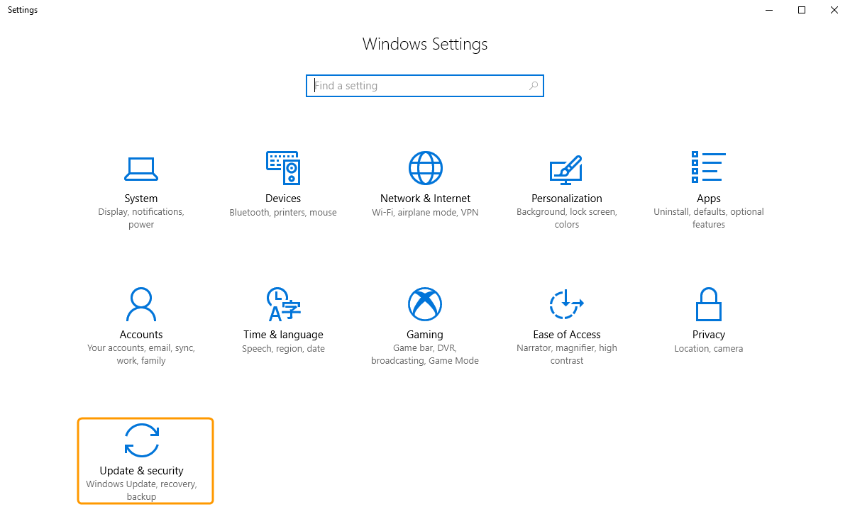
Configuring Settings
On the Windows Settings screen, click the Update & security option.

Slide 13
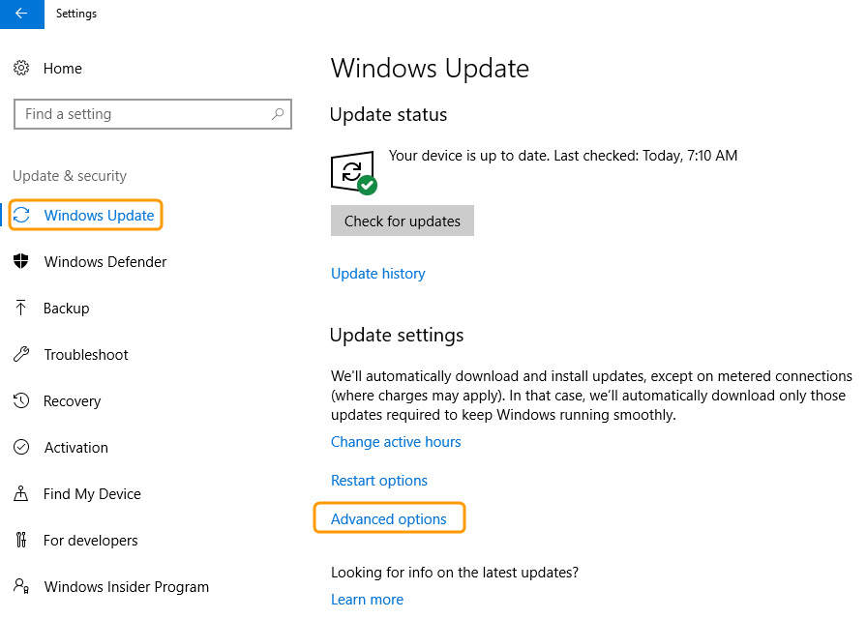
Configuring Settings
On the Windows Update tab, click the Advanced options link.

Slide 14
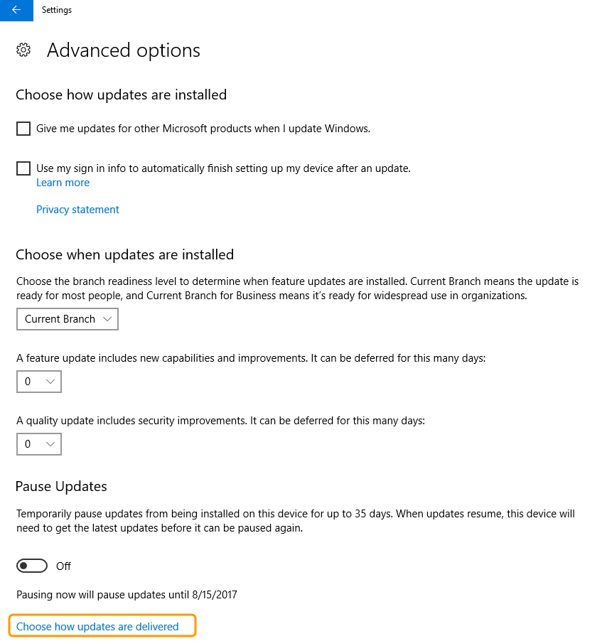
Configuring Settings
Click the Choose how updates are delivered link.

Slide 15
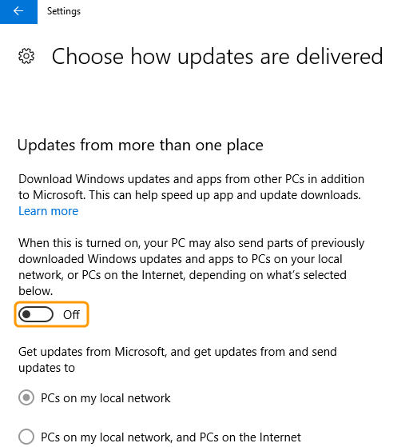
Configuring Settings
Set the Updates from more than one place option to Off.

Slide 16
Disabling World Wide Web Publishing Services

Slide 17
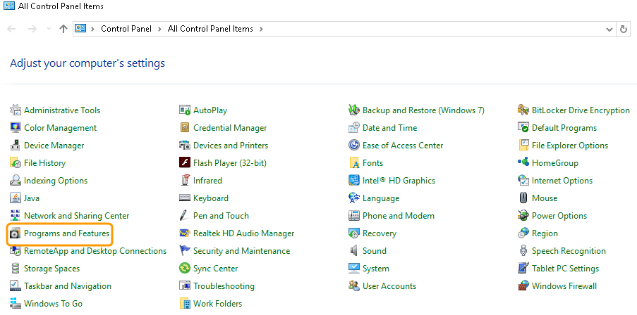
Disabling World Wide Web Publishing Services
Navigate to the Control Panel, and click the Programs and Features link.

Slide 18
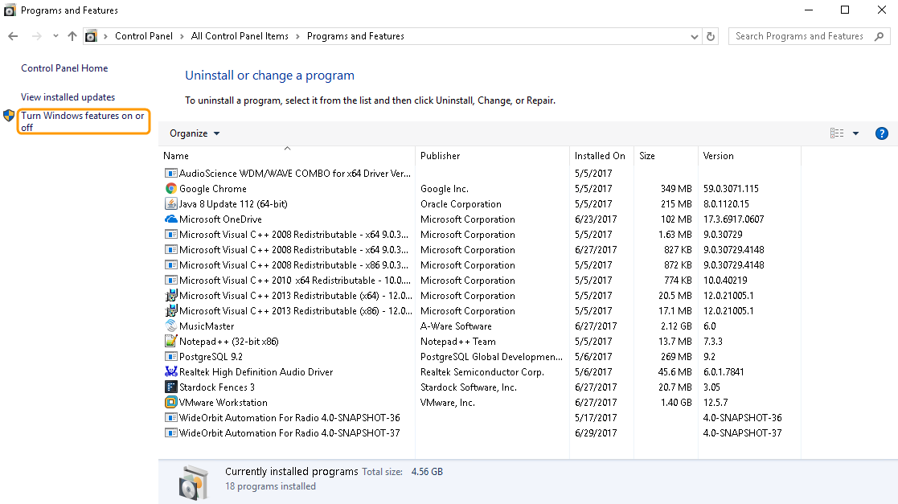
Disabling World Wide Web Publishing Services
Click the Turn Windows features on or off link on the left-hand side of the screen.

Slide 19
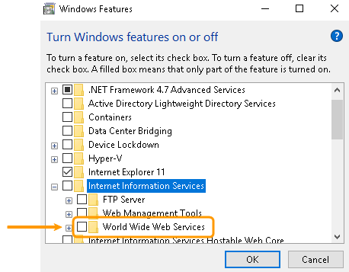
Disabling World Wide Web Publishing Services
Expand the Internet Information Services folder. Ensure World Wide Web Services is unchecked. Press OK.

Slide 20
User Accounts

Slide 21
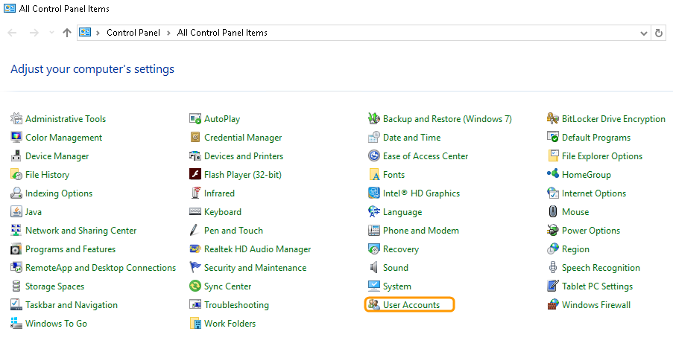
User Accounts
Navigate to the Control Panel, and click the User Accounts link.

Slide 22
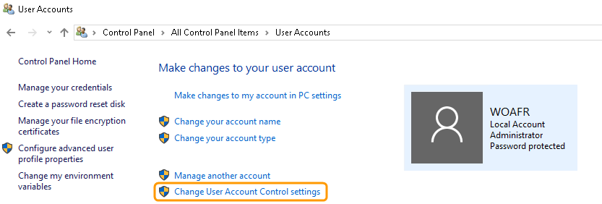
User Accounts
Click the Change User Account Control settings link.

Slide 23
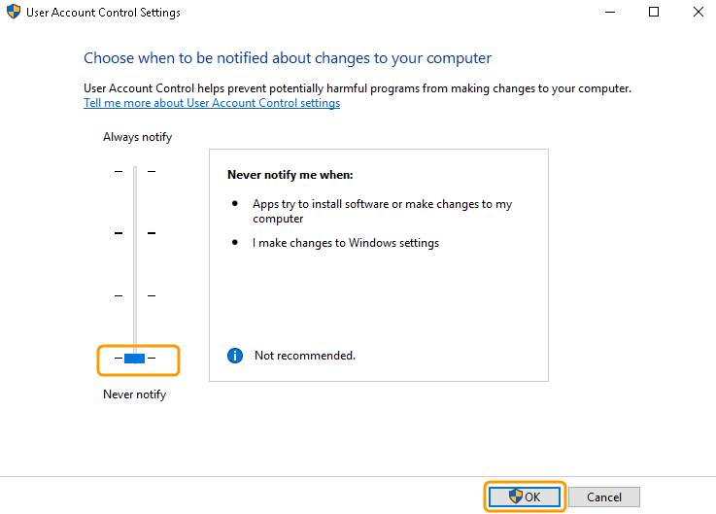
User Accounts
Move the slider to Never notify, and click OK to reboot.
When you click OK, you may see a dialog box about User Account Control. If so, click Yes when prompted.

Slide 24
Device Installation Settings

Slide 25
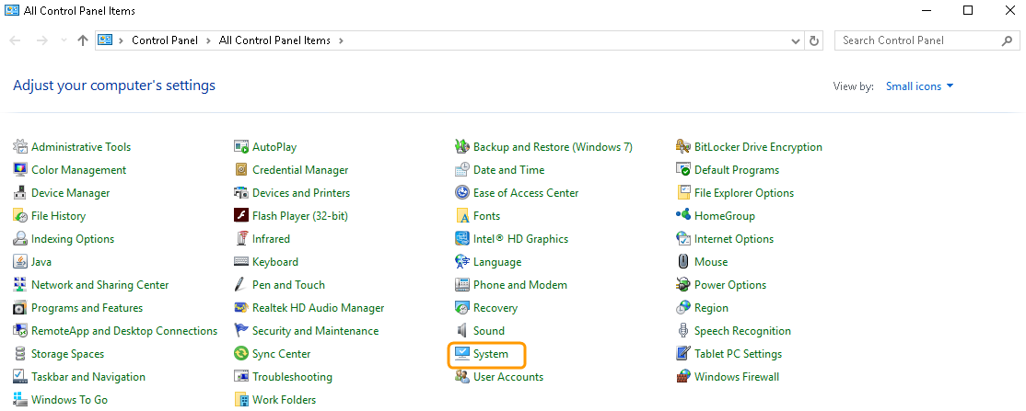
Device Installation Settings
Navigate to the Control Panel, and click the System link.

Slide 26
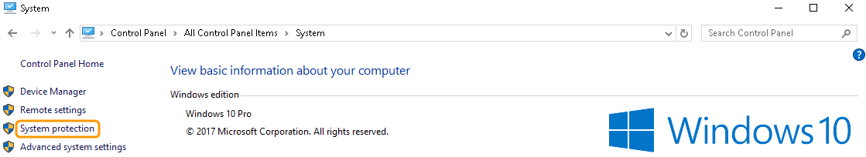
Device Installation Settings
Click the System protection link.

Slide 27
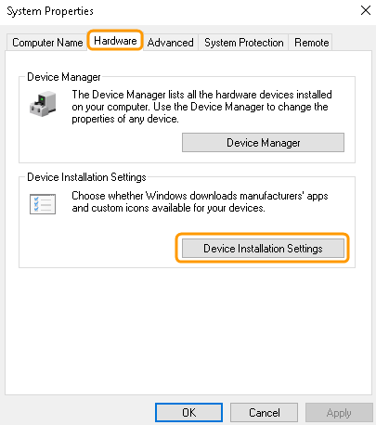
Device Installation Settings
Click the Hardware tab then click the Device Installation Settings button.

Slide 28
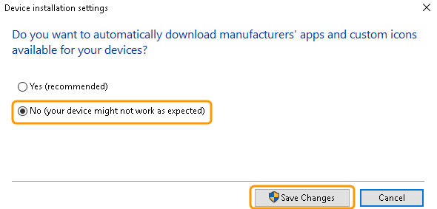
Device Installation Settings
Select No then click the Save Changes button.

Slide 29
Removing Onboard Audio Chipsets

Slide 30
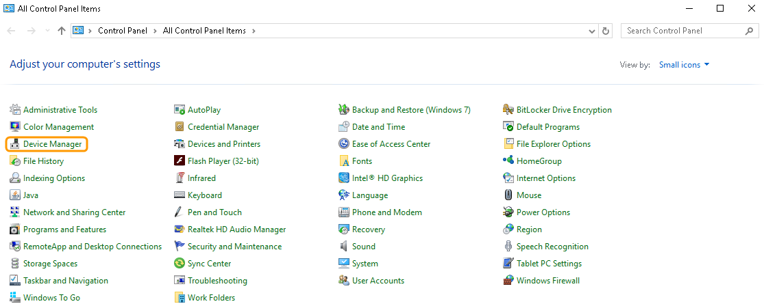
Removing Onboard Audio Chipsets
Navigate to the Control Panel, and click the Device Manager link.

Slide 31
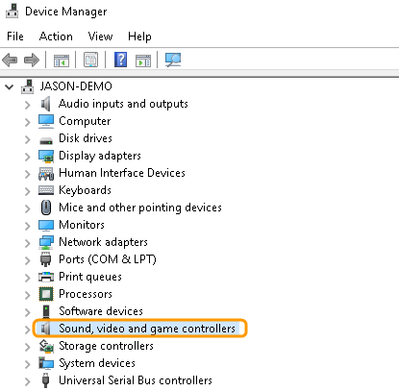
Removing Onboard Audio Chipsets
Confirm you see the Sound, video and game controllers option.
Removal may include items from Add/Remove Programs in Control Panel.

Slide 32
Disabling Simple File Sharing

Slide 33
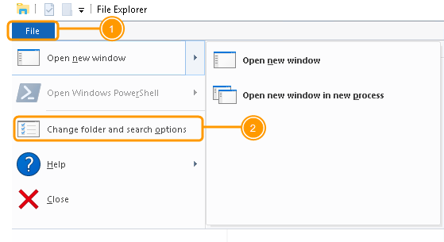
Disabling Simple File Sharing
Open File Explorer and click the File tab in the top left-hand corner.
Click Change folder and the search options from the drop-down menu.

Slide 34
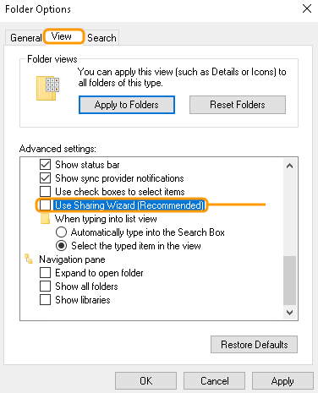
Disabling Simple File Sharing
Click the View tab on the Folder Options dialog box.
Scroll down to Use Sharing Wizard and ensure it is unchecked.

Slide 35
Setting Network Type as Private

Slide 36
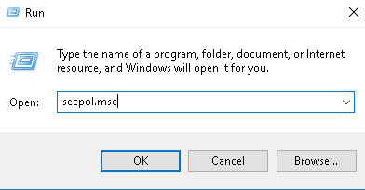
Setting Network Type as Private
Right-click on the Windows 10 icon, and click Run. In the Run dialog box type secpol.msc, and click OK.

Slide 37
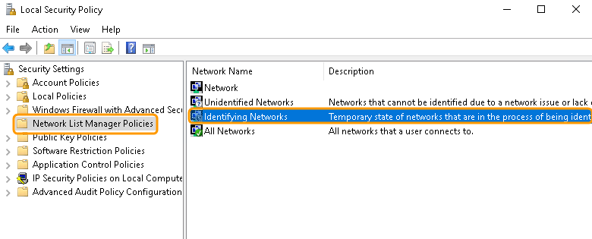
Setting Network Type as Private
Click the Network List Manager Policies folder and double-click the Identifying Networks option.

Slide 38
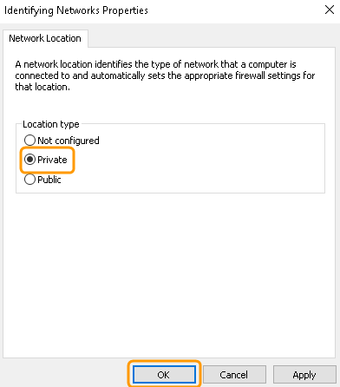
Setting Network Type as Private
Select Private, and press OK.

Slide 39
Disabling Gaming/DVR Settings

Slide 40
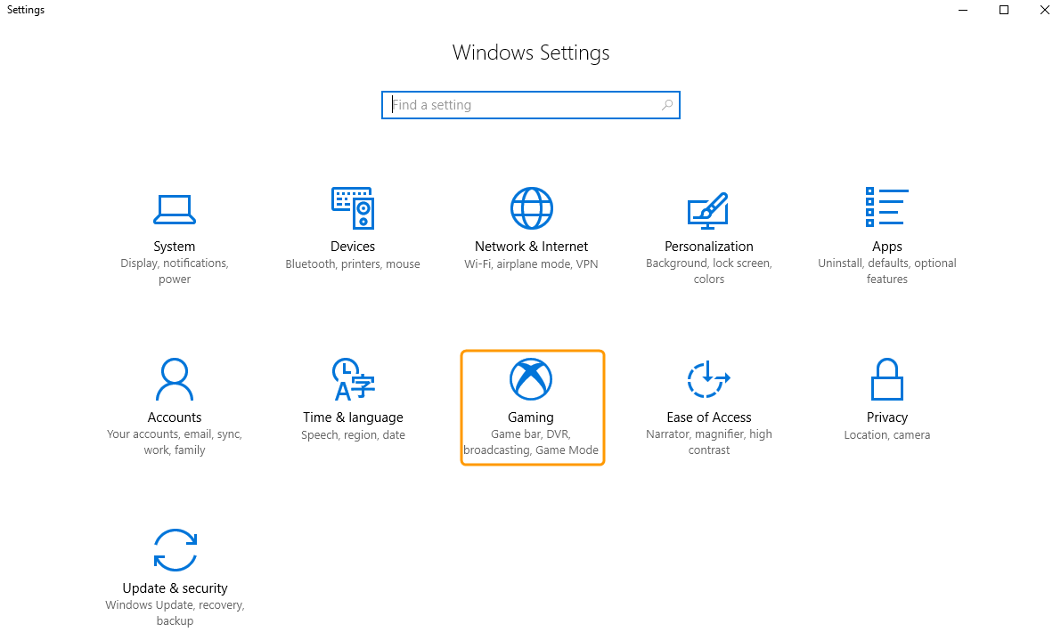
Disabling Gaming/DVR Settings
Click the Windows 10 icon, and click the Settings button. On the Windows Settings screen, click the Gaming option.

Slide 41
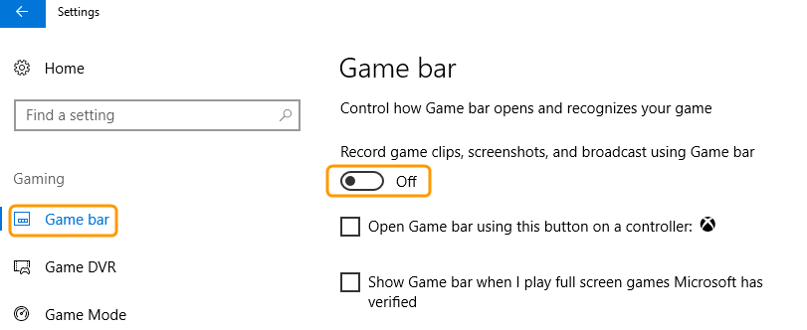
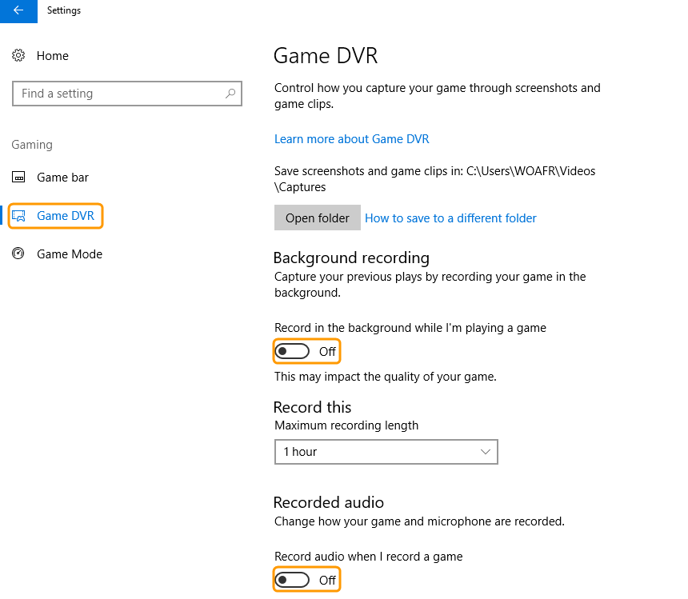
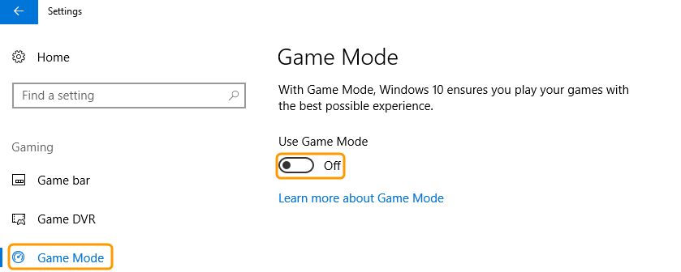
Disabling Gaming/DVR Settings
Disable all options on the Game bar, Game DVR, and Game Mode tabs.

Slide 42
Disabling IPv6

Slide 43
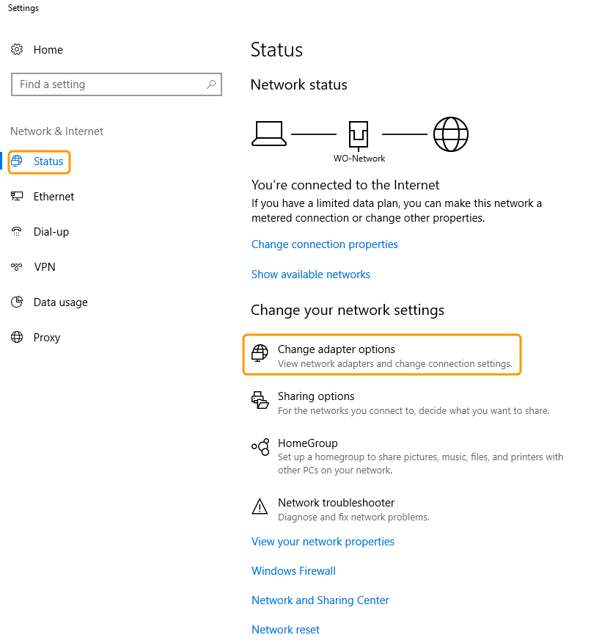
Disabling IPv6
Right-click the Windows 10 icon, and click Network Connections. Under the Status tab, click Change adapter options under the Change your network settings section.

Slide 44
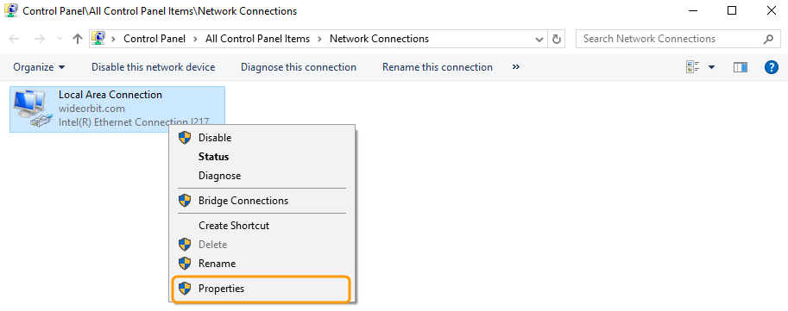
Disabling IPv6
Right-click on the network you wish to change, and select Properties.

Slide 45
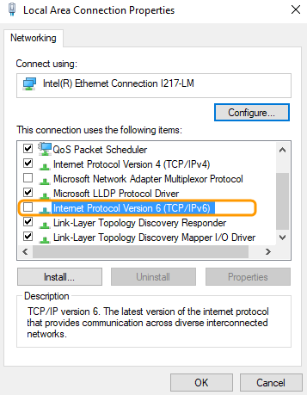
Disabling IPv6
Ensure Internet Protocol Version 6 is unchecked.

Slide 46
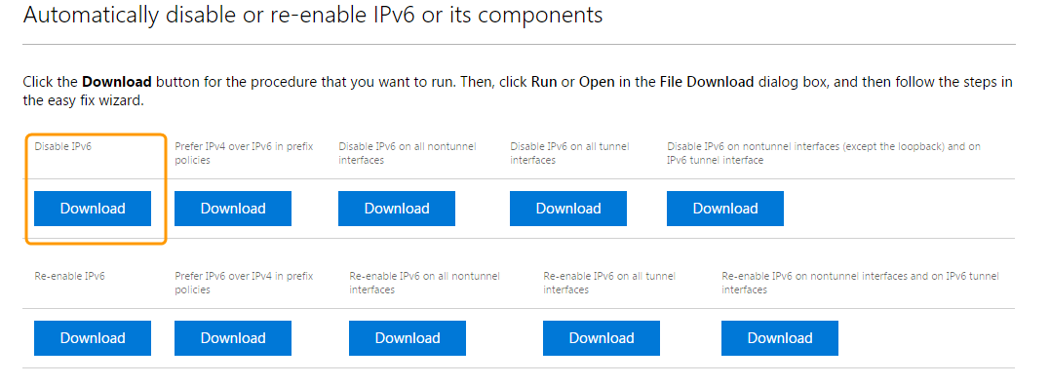
Disabling IPv6
To fully disable IPV6 from your computer, visit the following hyperlink. Click the Download button for Disable IPv6.
https://support.microsoft.com/en-us/help/929852/how-to-disable-ipv6-or-its-components-in-windows

Slide 47
Uninstalling Native Windows Apps

Slide 48
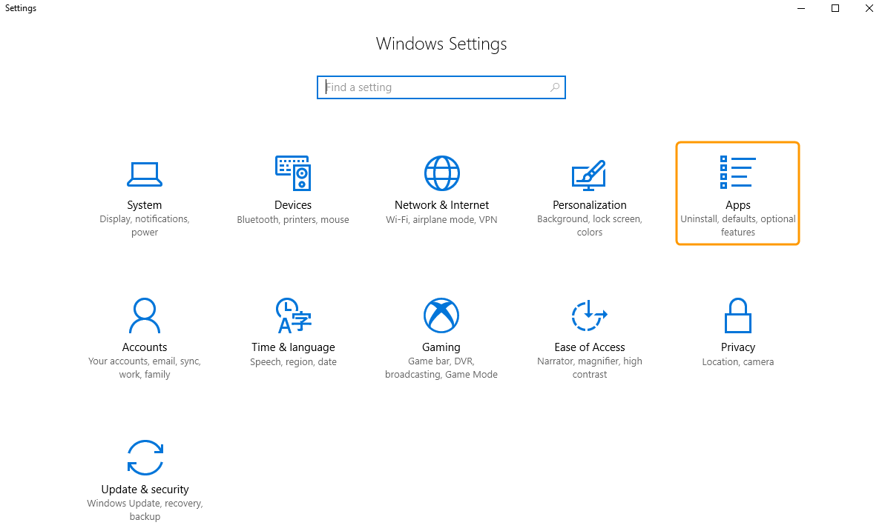
Uninstalling Native Windows Apps
Click the Windows 10 icon, and click the Settings button. On the Windows Settings screen, click the Apps option.

Slide 49
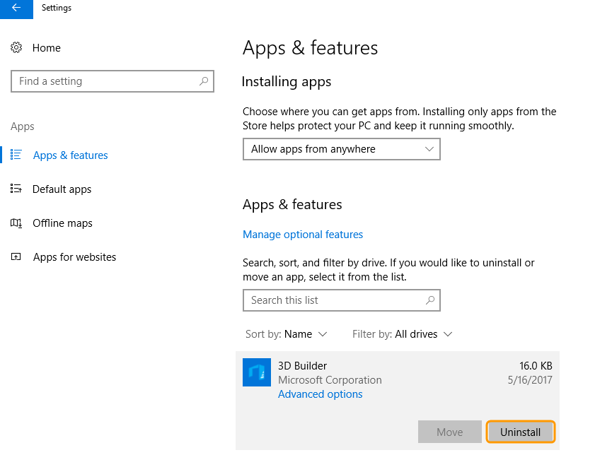
Uninstalling Native Windows Apps
Click on the app you wish to uninstall and press the Uninstall button.

Slide 50
Disabling Background Apps

Slide 51
Disabling Background Apps
On the Windows Settings screen, click the Privacy option.

Slide 52
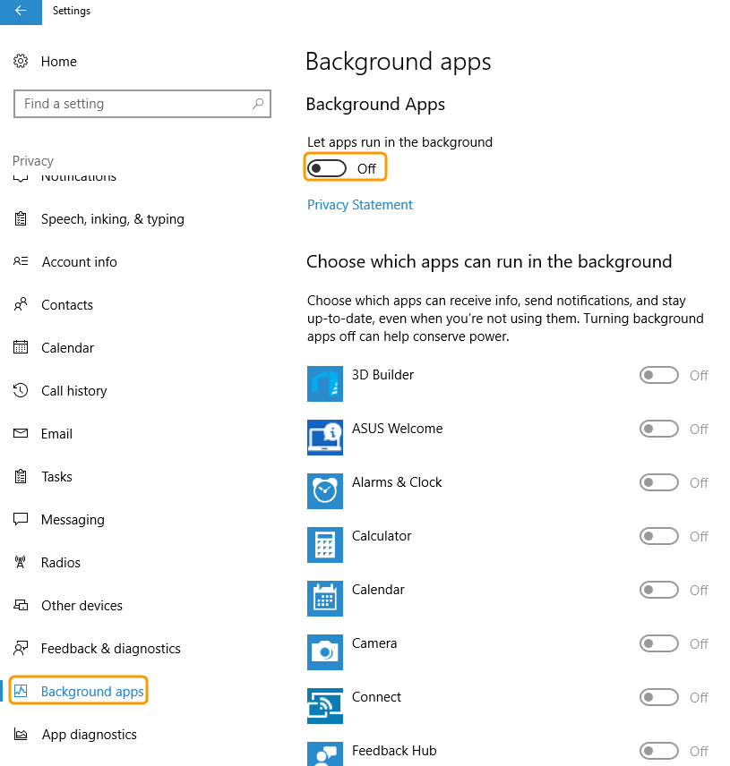
Disabling Background Apps
On the Background apps tab, set the Background Apps option to Off.

Slide 53
Disabling Background Apps
We also recommend disabling everything within the Privacy option. Select each tab from the left-hand side of the screen, and set each option to Off.

Slide 54
Changing Power Options

Slide 55
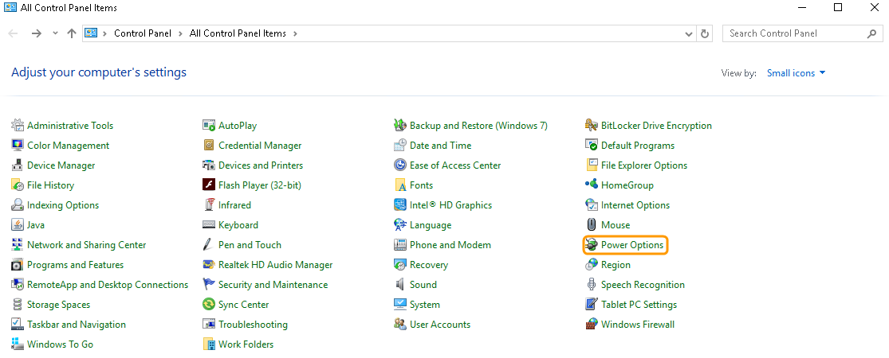
Changing Power Options
Navigate to the Control Panel, and click the Power Options link.

Slide 56
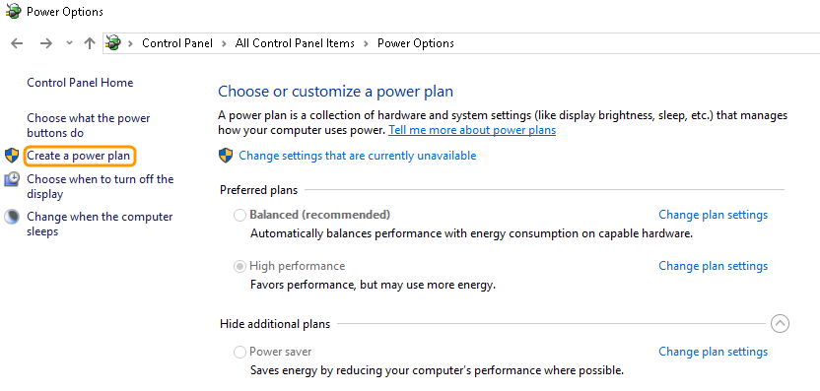
Changing Power Options
Click the Create a Power Plan link on the left-hand side.

Slide 57
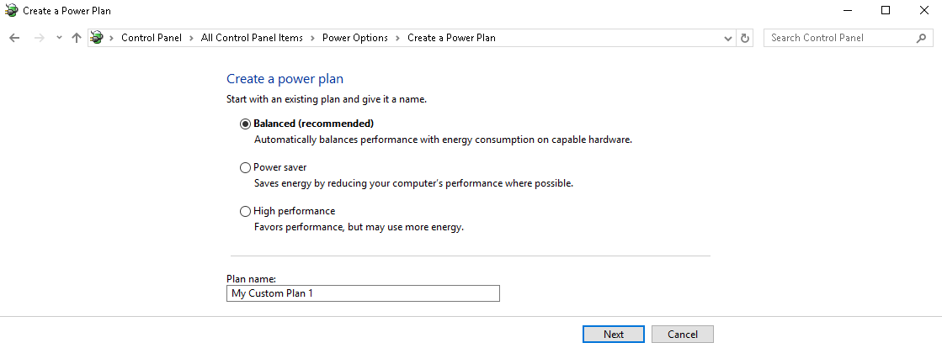
Changing Power Options
Select or create a plan that never puts the computer to sleep or turns off the display or hard drive.

Slide 58
Verifying Virtual Memory Management Assignment

Slide 59
Verifying Virtual Memory Management Assignment
Navigate to the Control Panel, and click the System link.

Slide 60
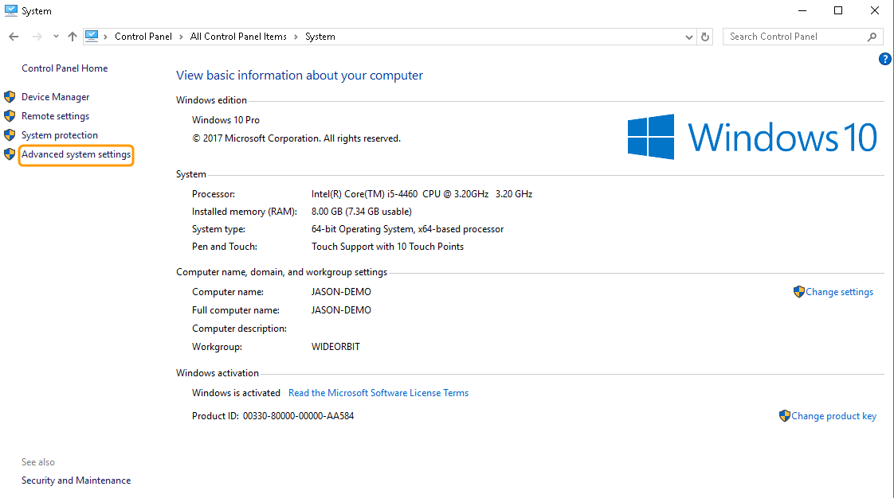
Verifying Virtual Memory Management Assignment
Click the Advanced system settings link on the left-hand side.

Slide 61
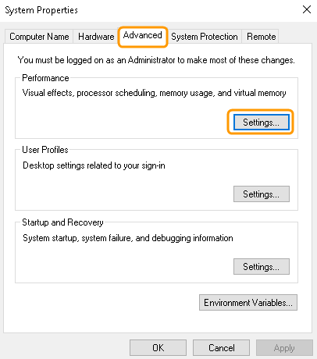
Verifying Virtual Memory Management Assignment
On the Advanced tab, click the Settings button under the Performance section.

Slide 62
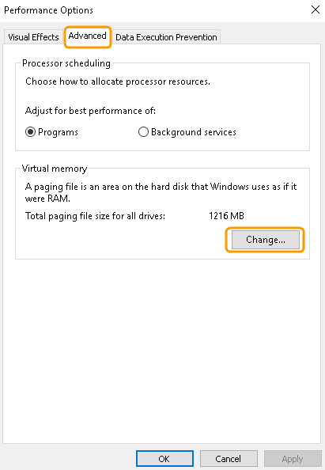
Verifying Virtual Memory Management Assignment
On the Performance Options dialog box, click the Advanced tab; click the Change button under the Virtual memory section.

Slide 63
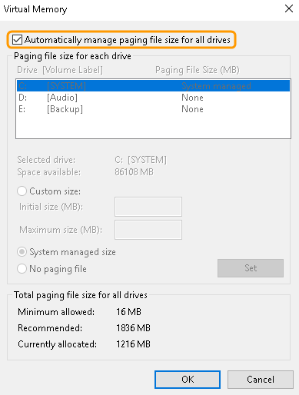
Verifying Virtual Memory Management Assignment
Select Automatically manage paging file size for all drives. Click OK.

Slide 64
Turning off Windows Updates Entirely

Slide 65
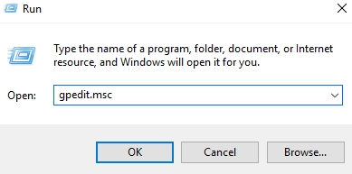
Turning off Windows Updates Entirely
Right-click the Windows 10 icon, and click Run. In the Run dialog box, type gpedit.msc, and click OK.

Slide 66
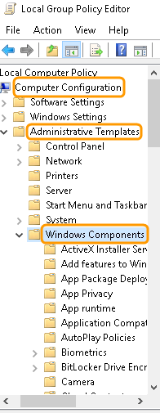
Turning off Windows Updates Entirely
From the Computer Configuration drop-down menu, expand the Administrative Templates folder and expand the Windows Components folder.

Slide 67
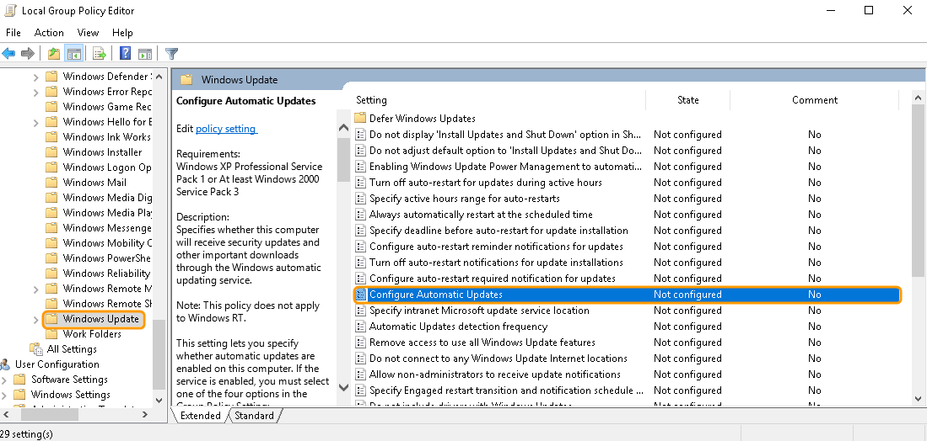
Turning off Windows Updates Entirely
Under the Windows Components section and toward the bottom, click Windows Update. From the list on the right-hand side of the dialog box, double-click Configure Automatic Updates.

Slide 68
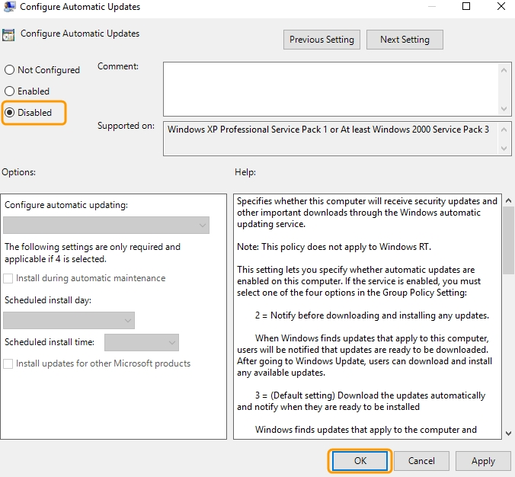
Turning off Windows Updates Entirely
Select Disabled, and click OK.

Slide 69
Thank You
Q&A

Slide 70
Thank You
Michelle King
Sales Manager
mking@wideorbit.com
(208) 413-3661

